Slide 1
DATA SCIENCE
10 WEEK PART TIME COURSE
Week 2 – Command History

Slide 2
AGENDA
Recalling history

Slide 3
ipython history
DATA SCIENCE PART TIME COURSE

Slide 4
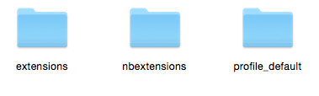
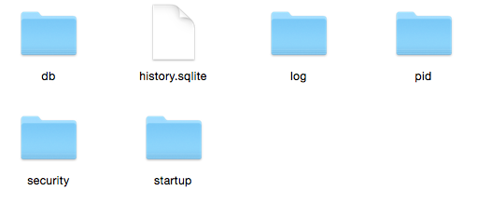
ipython history
Semi-invisible folder called “.ipython” in your home directory
Windows: C:\Users\yourname\.ipython
OSX/Linux: ~/.ipython
Command history database

Slide 5

What is SQLite?
Free, tiny, embedded SQL database
The most popular database in the world
Python (including pandas) can read it
Command-line interface: sqlite
Download it manually if nothing else has
Small. Fast. Reliable.
Choose any three.

Slide 6
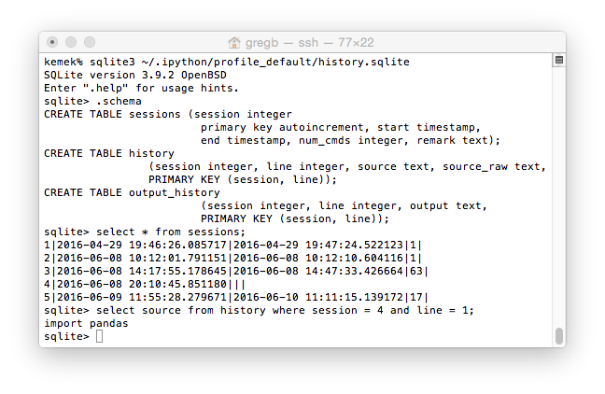
SQLite session

Slide 7
Command Shell
DATA SCIENCE PART TIME COURSE

Slide 8
BASH (Default UNIX / Linux / OSX Shell)
Stored in a plain text file
Environment variable called “HISTFILE”
Default file is ~/.bash_history
Show last 20 with history 20
Or tail -20 ~/.bash_history

Slide 9
MS-WINDOWS
Cmd.exe: doskey /history
Powershell: Get-History 10 –count 10

Slide 10
Any Requests? Cities & Populations?
DATA SCIENCE - Week 2 Day 1

